Slide 1
Guerrilla Accessibility
Kevin Lanahan
MO Department of Conservation

Slide 2

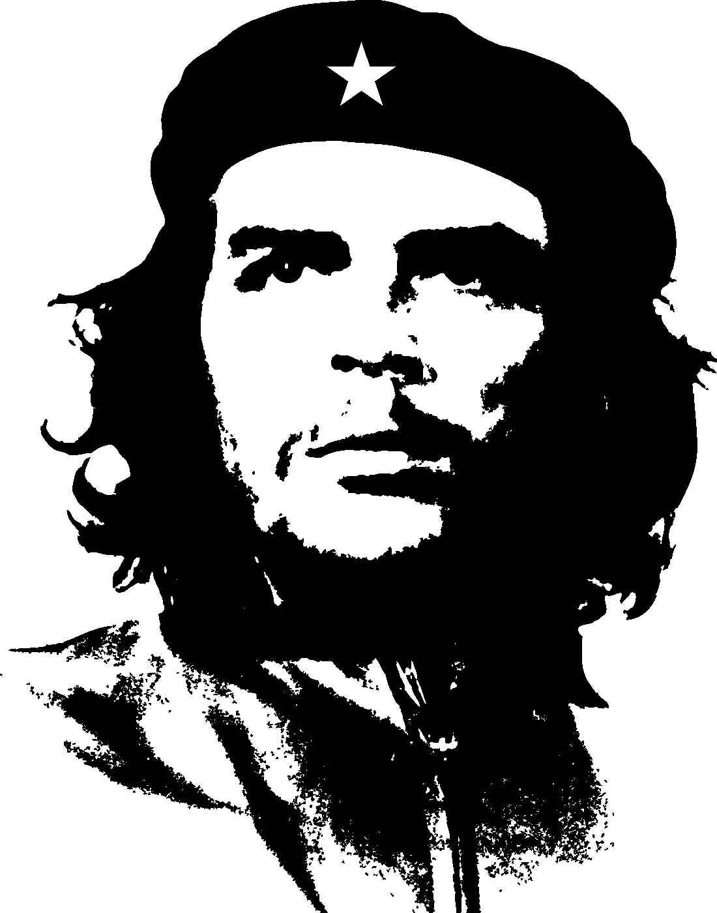
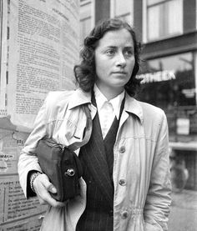
Guerrilla Accessibility
You need two things:
An ideology
Guerrillas
Notes:
Ideology: A philosophy, a cause.
Guerrilla: an activist. Someone who is willing to take a stand for what he or she believes

Slide 3
About Me
I started working on government web in 1996
I embrace standards.
I have friends and family who are blind, deaf, autistic, color-blind, and paralyzed.
I can also talk about bicycles and bourbon.
Notes:
1996: before IE was bundled with Windows
Why do I embrace standards? Because I lack creative imagination.

Slide 4
Quick Survey
Notes:
Show of hands.
Who’s heard of Section 508 or WCAG?
Who thinks accessibility is something that you only have to worry about if you are in government?
Who thinks it’s someone else’s job (like Drupal security)?

Slide 5
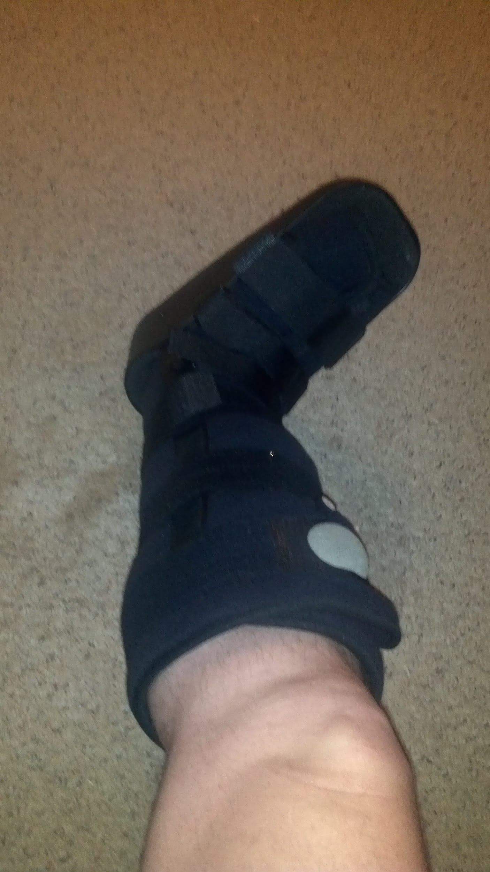
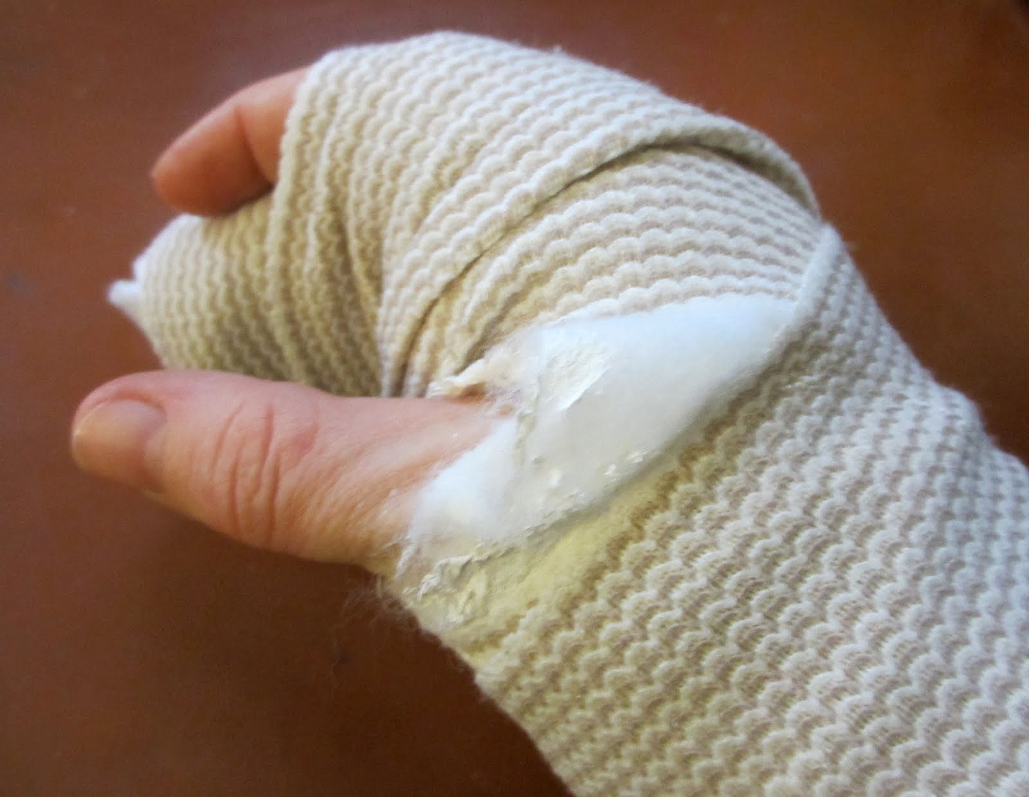
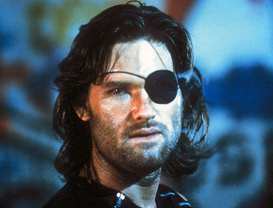
Everybody has a disability... or will.
Notes:
Could just be temporary, could be permanent.
Could be physical, could be perceptual.

Slide 6
Missouri stats
155,300 blind Missourians in 2014
81% age 35 or older
100,000 Missourians are deaf or hard-of-hearing
In 2013, 838,300, or 14%, of Missourians classified themselves as “disabled”
34% of them are employed.
Notes:
Disabled: visual, hearing, ambulatory, or cognitive disability.

Slide 7
Your sites need to be accessible
But it’s hard.
I’m not sure how.
My boss won’t let me.
My developers don’t understand.
It limits my design decisions.
Notes:
All heard at NOLA Drupalcon 2016

Slide 8
How accessible do I need to be?
Back-end Drupal user interface
Drupal 7 is sort of accessible.
Drupal 8 is better.
Is my custom code accessible?
Is my display accessible?
Is my content accessible?
Notes:
We’re gonna concentrate on the last three.
Display: Skip nav, nested headings, no naked div tags
Content: Keep the content contributors from messing things up.

Slide 9
Ideology: This is for everyone.
We know about accessibility.
We believe in it.
We know it makes the internet better.
We think everyone should do it.
We need to change hearts and minds.
Notes:
If you adopt standards-based HTML output, this gets much, much easier.

Slide 10
This is for everyone
Accessible design is good design. Everything we build should be as inclusive, legible and readable as possible. If we have to sacrifice elegance — so be it. We’re building for needs, not audiences. We’re designing for the whole country, not just the ones who are used to using the web. The people who most need our services are often the people who find them hardest to use. Let’s think about those people from the start.
https://www.gov.uk/design-principles
Notes:
https://www.gov.uk/design-principles#sixth

Slide 11
But changing hearts and minds is hard....

Slide 12
Guerrillas
guer·ril·la
ɡəˈrilə/
Noun: a member of a small independent group taking part in irregular fighting, typically against larger regular forces.
Adjective: referring to actions or activities performed in an impromptu way, often without authorization.
Notes:
You could call them ninjas, too.

Slide 13
508 and WCAG 2.0 AA
The usual reasons:
It’s the right thing to do.
It increases SEO.
It’s the law (if you contract with the state or feds).
Use WCAG 2.0; That’s what 508 will turn into.
508: Section 508 of the Rehabilitation Act of 1973
WCAG: Web Content Accessibility Guidelines

Slide 14
POUR
Perceivable
Operable
Understandable
Robust
Notes:
Perceivable: can you read it, hear it, touch it, or experience it?
Operable: can you interact with it, with a mouse, touchpad, keyboard, voice command? Can you override time limits? Recover from errors (confirmation screens, error warnings.
Understandable: is the language identified? Do the words in navigation make sense?
Robust: Use valid code, follow standards, decide how far back to make compatible.

Slide 15
Perceivable
Alt-text for all images
Form elements labeled
Semantic markup (no naked div tags)
Tables are for data
4.5:1 color contrast
No pictures of text
Close-captions for video
Notes:
Seriously, valid html is 90% of accessibility.

Slide 16
Operable
Navigate by keyboard
No keyboard traps
No content flashes more than 3 times/second
Skip Nav link
Contextual links
Meaningful headings
Notes:
Keyboard traps: like getting to a checkout page and not being able to continue.

Slide 17
Understandable
Identify page language <html lang="en">
Reading level
Predictable behavior
Error identification (intuitive form validation)
Notes:
Keyboard traps: like getting to a checkout page and not being able to continue.

Slide 18
Robust
Valid code
Future-proof
Notes:
Keyboard traps: like getting to a checkout page and not being able to continue.

Slide 19
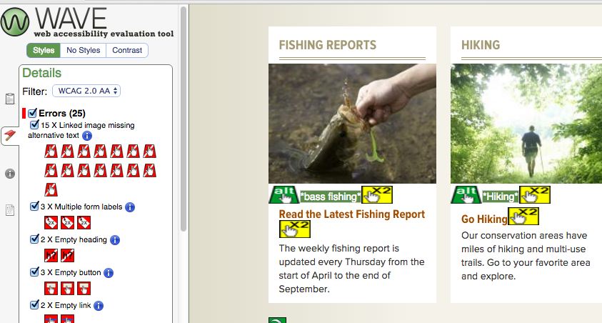
Wave results
Notes:
From mdc.mo.gov.

Slide 20
Design
Mark up wireframes with appropriate tags.
Check color contrast.
Review the site in dev. Find problems early.
Build accessibility reviews into the timeline.
Notes:
Just do simple tests.
Test for HTML validation.
Use WAVE.
Tangaru.com checks contrast and offers suggestions.
Navigate by keyboard.

Slide 21

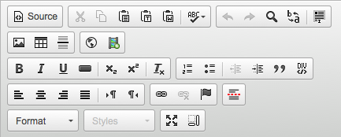
Limit content contributor options
Do This
Titles become H1.
Edit CKEditor to restrict options.
Not That
Notes:
Limit their options. Paragraphs module may be useful.

Slide 22
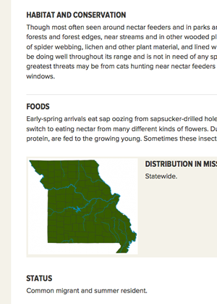
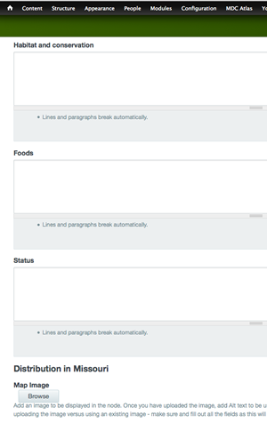
Chunk Your Content
Break content types up
into small pieces.
Notes:
You can control headings while limiting editor options.

Slide 23
Document and Train
Document content entry
Document coding standards
Train the devs/users
Train them again
OMG, you just got a bunch of new developers! Train again!

Slide 24
Changing hearts and minds
Empathy initiative:
Bring in an accessible technology user
Show how AT works
Use examples from your agency
Put a face on accessibility
Notes:
This came out of a need to get our content contributors on board with how to provide structured content.
MDC site was pretty accessible before Drupal. Our contractors didn’t quite get it, and checks for accessibility were lost in the race to get online.
Always had a problem with our PDFs. Designers didn’t know how to make InDesign accessible.
Power Up! Conference.

Slide 25
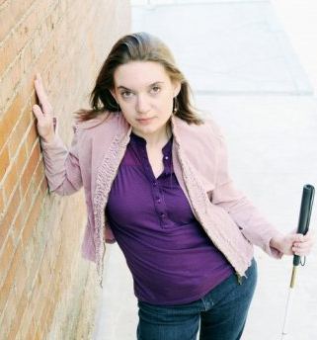
Meet Gretchen
Notes:
Was a gamer and early adopter on social media
Lost her vision in college.
Finished her undergrad and masters at University of Missouri.
Is currently working for a public interest group.

Slide 26
Empathy Strategy
Three-part presentation:
How a blind person uses a computer and browser.
How PDFs are generally awful.
How participants can make improvements right now.
Notes:
Initially targeted content contributors and print designers.
We could tell them to adopt a new workflow, but it made more sense to show them why.

Slide 27
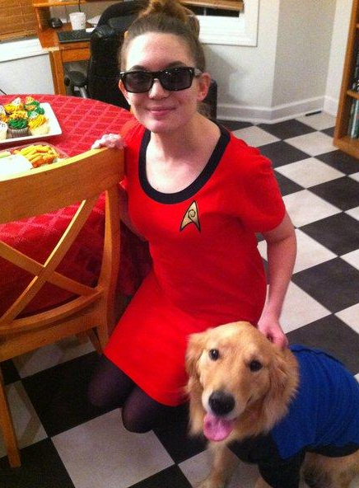
Tailored to the audience
Content contributors
Developers
App developers
Total nerd credentials
Notes:
Uses a computer with screen reader and iPhone with VoiceOver

Slide 28
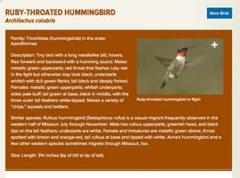
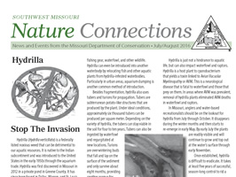
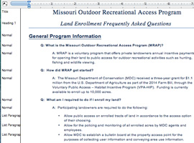
Relevant Examples
Demonstrate a screen reader
Demonstrate web pages, PDFs, and Word docs, using examples from our agency
Give users 4 take-away tips for improving Word accessibility immediately.
Notes:
4 tips: Use draft mode, headings, styles, and save as tagged pdfs

Slide 29
Resources
HTML validator
Chrome HTML validator (also available for Firefox)
Web Developer Toolbar (Firefox, with a Chrome port)
Color Contrast
http://contrast-finder.tanaguru.com/
Accessibility:
WAVE toolbar for Chrome

Slide 30
Questions?
Kevin.Lanahan@mdc.mo.gov

Slide 31
Sources
http://www.afb.org/info/blindness-statistics/state-specific-statistical-information/missouri/235
http://libguides.gallaudet.edu/content.php?pid=119476&sid=1029190
http://www.disabilitystatistics.org/StatusReports/2013-PDF/2013-StatusReport_MO.pdf

